Slide 1

Unicorn Predictor
Callie Yu
Gabriel Silva
Norman Chen
Edgar Coronado
Notes:
Edgar
Joe Rogan once said that an unicorn is a donkey from the future. Now, Joe Rogan is a smart dude, so I’ll have to agree with him on this one. Now, my only only question is, how can do you separate the unicorns from the donkeys?
That my friends, seems to be a common dilemma with investors and lenders, which is why with the help of Callie, Gabriel, and Norman, we created Unicorn Predictor.

Slide 2
Our Mission
Problem
Startup growth financing dilutes ownership and can be very time consuming
Solution
Our Machine Learning Models allow us to provide capital in order to scale the startup without diluting ownership, all done in minutes
We are not a bank, we’re not a Venture Capital firm, we are Unicorn Predictor!
Notes:
Edgar
Let’s forget about the investors and lenders for a bit, and shift that focus to the founders, who are the bright minds behind the ideas that are set to change the world that we live in. As these ideas start forming into a business, they start demanding time, dedication, and most importantly, funding. As they continue into the various funding stages, the founders start to realize that every new round is diluting their ownership, and creating a messy cap table.
This is where we come in. We’re here to provide access to capital to startups without diluting their ownership, personally guaranteeing, or spending hours on countless paperwork. Our ideal clients are those who have already gone through market testing, launched their product, are building traction through a working business model, and have received some type of funding through Accelerators, Angel Investors or VC’s.
Our mission is to allow our founders to continue to innovate, scale their business, outlive their competitors and go from a donkey to a unicorn.
With that being said, I’ll hand it over to Callie to discuss the technologies and data sources that we use to make this all happen.

Slide 3
Technologies & Data Source
Python
Pandas
Numpy
SKLearn
MatPlotLab
hvplot
Amazon Lex
Kaggle
Notes:
Callie

Slide 4

Key Data Points
We decide whether to approve an applicant through our Startup Success Predictor, in which we take the following data into consideration:
Industry
Funding Rounds
Funding Received
Number of Investors Average funds raised
Average time between rounds
Annual Recurring Revenue (ARR)
Notes:
Gabriel

Slide 5
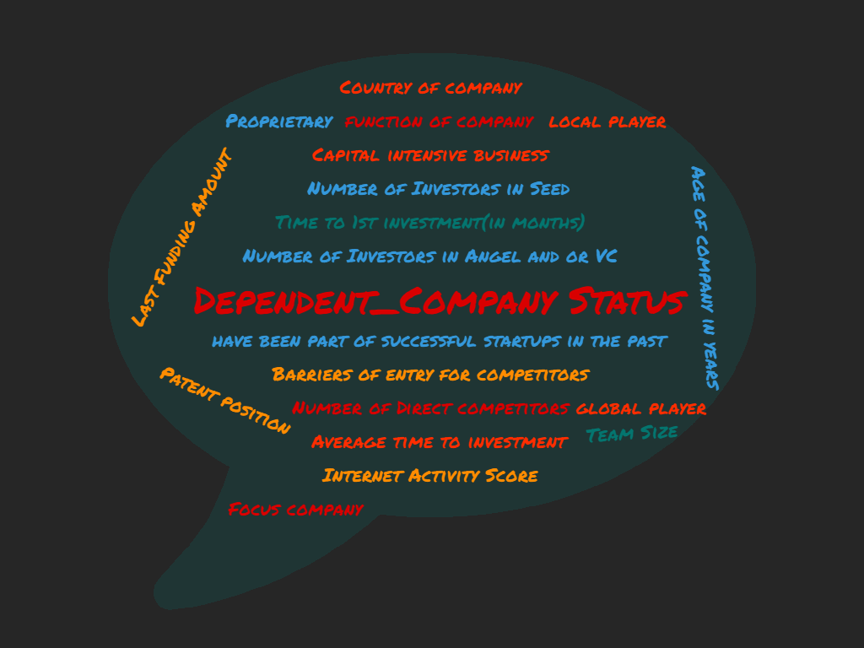
Aggregate Data Collected
Dependent Company Status
y-column
Everything else:
X-columns
Notes:
Norman
Moving on to the next slide: classifier models we tested our product with ------>

Slide 6
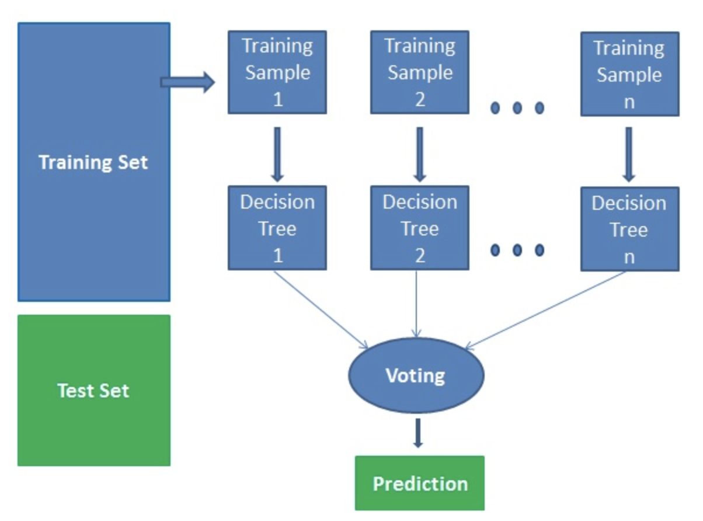
Model: Random Forest Classifier
The algorithm works in 4 steps:
Select random samples from given dataset
Construct a decision tree for each sample and get a prediction result from each decision tree
Perform a vote for each predicted result
Select the prediction result with the most votes as the final prediction
Notes:
Edgar
The first machine learning model that we tried was the random forest classifier, in which the algorithm works in 4 steps:
Selects random samples from given dataset
Constructs a decision tree for each sample and gets a prediction result from each decision tree
Performs a vote for each predicted result
Selects the prediction result with the most votes as the final prediction
Next, Callie will go over the 2nd model we tested.
https://www.datacamp.com/community/tutorials/random-forests-classifier-python

Slide 7
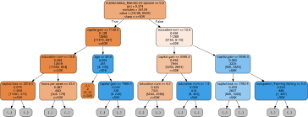
Classification Tree
In our data, we see that a classification tree gives us 48/118 true positives and 70/118 true negatives.
The accuracy , precision, sensitivity, and specify is 100 percent for our model
Notes:
Callie
How the model works and the algorithm-- over fit model

Slide 8
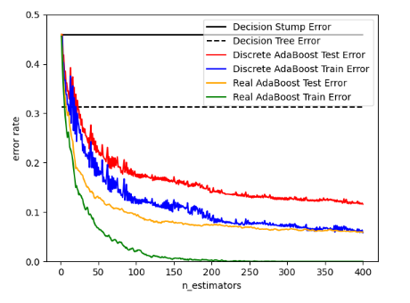
Models: AdaBoost
Multiple Weak Learning Models
Weighed differently
Each iteration changes weights
Will average every small model into the big model in the end
In our situation, we believe this model was overfitted as it gave us a 100% prediction on our train/test data
Notes:
Norman

Slide 9
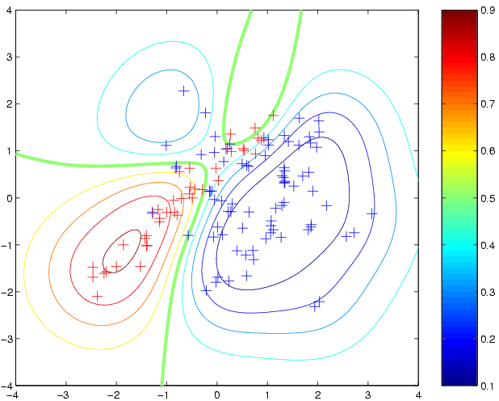
Gaussian Process Classifier Model
Prediction is probabilistic
Returns a classification
yes/no
1/0
Goes off regular distribution
Notes:
Norman

Slide 10
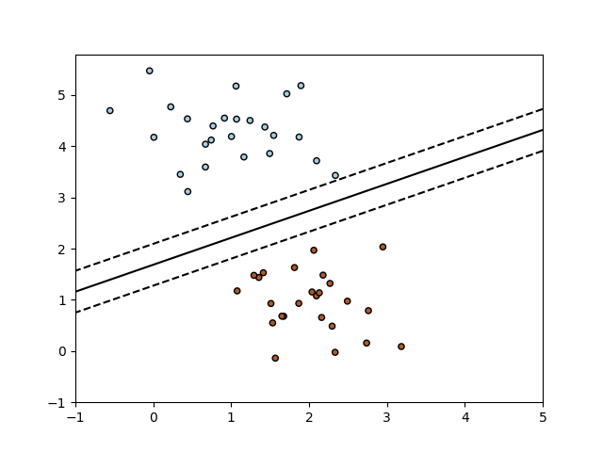
Models: Stochastic Gradient Descent
Data points separated by a hyperplane
Support vectors act as guidelines to establish a line which divides the data in a which which minimizes loss
Notes:
Gabriel

Slide 11
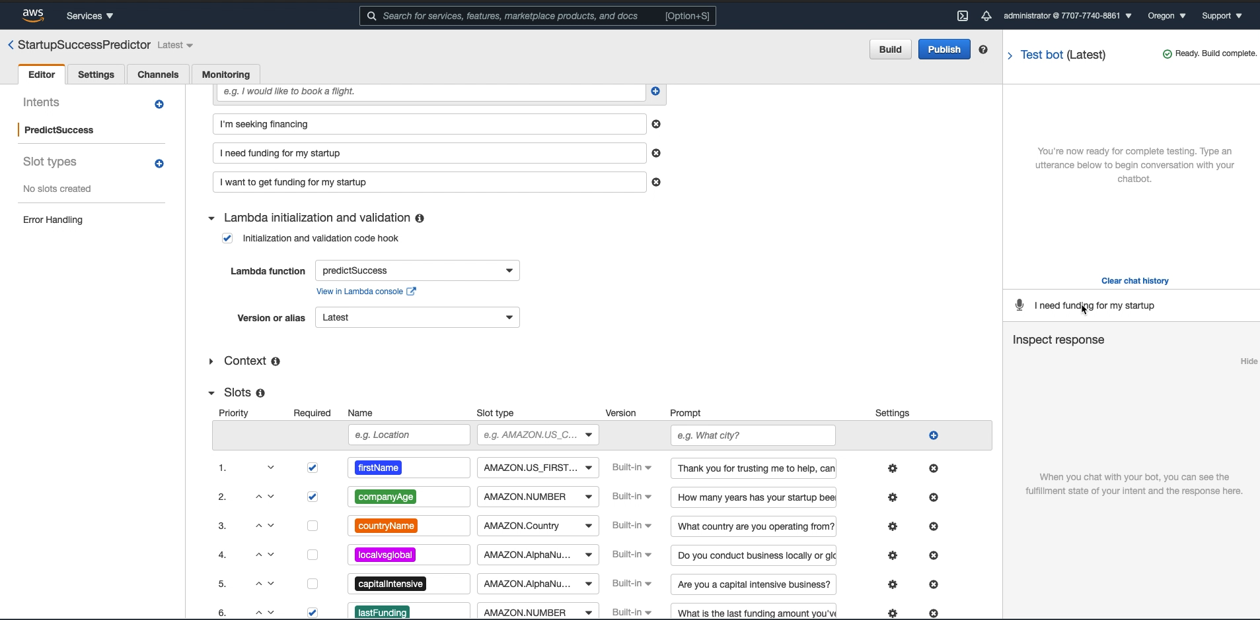
Amazon Lex Demo
Notes:
Edgar

Slide 12
Unicorn Predictor 2.0
Extensive network of investors
Vertical Lending
Startup Success Rate
Notes:
As we continue to scale our startup, there are 3 main components that we’re looking at for our 2.0 version. The first one is
1) Extensive network of investors that can provide expert advice or additional funding if needed
2) Vertical Lending - A couple examples are e-commerce businesses that are seeking capital for ad spend or inventory and SaaS businesses that are looking to leverage their MRR’s to obtain capital. We think that if we can specialize on certain verticals, we can obtain a great market share through insights and data points that our competitors might not leverage, and therefore, be the go to lender for these industries.
Which brings us to our 3rd focus:
3) Additional data points - Currently we would use our Unicorn Predictor to state whether we should provide funding to startups or not. We take in a few parameters that can help us gauge that, but we would like to leverage more data points and train our model to give us a percentage of success that the applicant has based on their input. That information will then translate to how much we funding we can provide.

Slide 13

Questions?

